Slide 1



Slide 2

Cheers!
Subscription based website
Audience: Mixology students and Cocktail Enthusiasts
One stop destination

Slide 3

Concept
What is Online Barkeep?
Why did we create Online Barkeep?
Benefits of Online Learning?
Who will use Online Barkeep?

Slide 4

Process
Technologies used | Foundation (https://get.foundation/) TheCocktailDB API (https://www.thecocktaildb.com/api.php) Food Database API (https://developer.edamam.com/food-database-api-docs) HTML, CSS, JavaScript, jQuery, Google Font, Font Awesome
Tasks and Roles | Johnny - HTML Malek - JavaScript Ojashri – PPT & Readme Rohan – HTML & PPT Shanshan - CSS Terrence – Github manage, review work, In phase 2, we worked issues together.
Our Challenges | Github technical issues, has conflict when push the work to Gihub Original we plan to use Google Map API to make map search, however, it not really related to our cocktail API, so we have to change the idea to show Food Database API in week two.
Our Successes | Resolve Github issues together Quickly changed to Food Database API and made it function. Almost completed two websites to adopt multiple screen size before presentation date

Slide 5

Demo

Slide 6
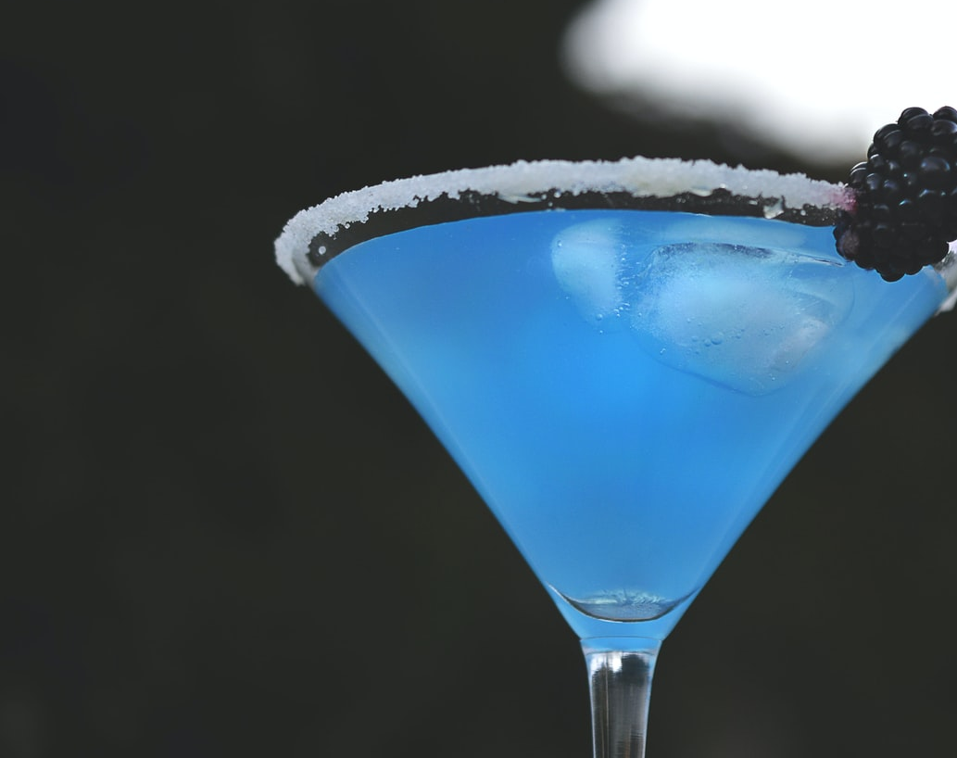
Directions for Future Development
Nearest LCBO Search
Bartender Job Search
Wine and Cheese Platters
Ingredients Definition/Link to Wikipedia

Slide 7
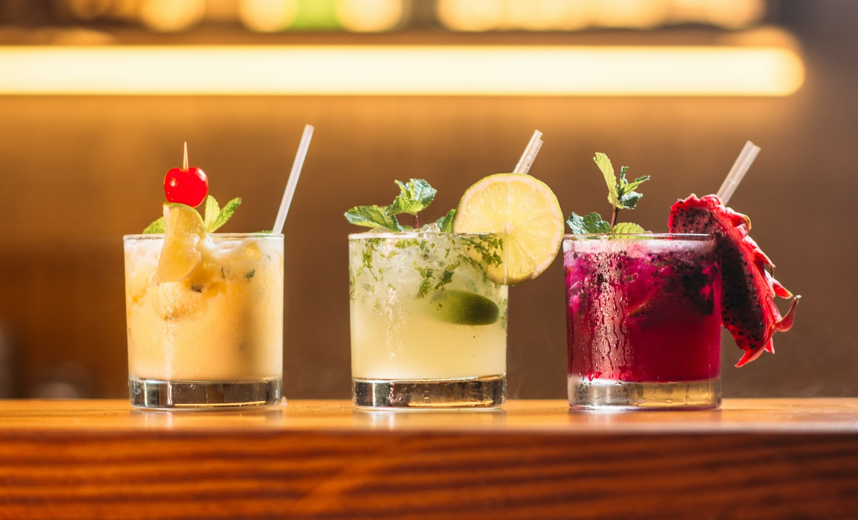
Links
https://github.com/uoft-project1-group5/cocktail-map

